Slide 1
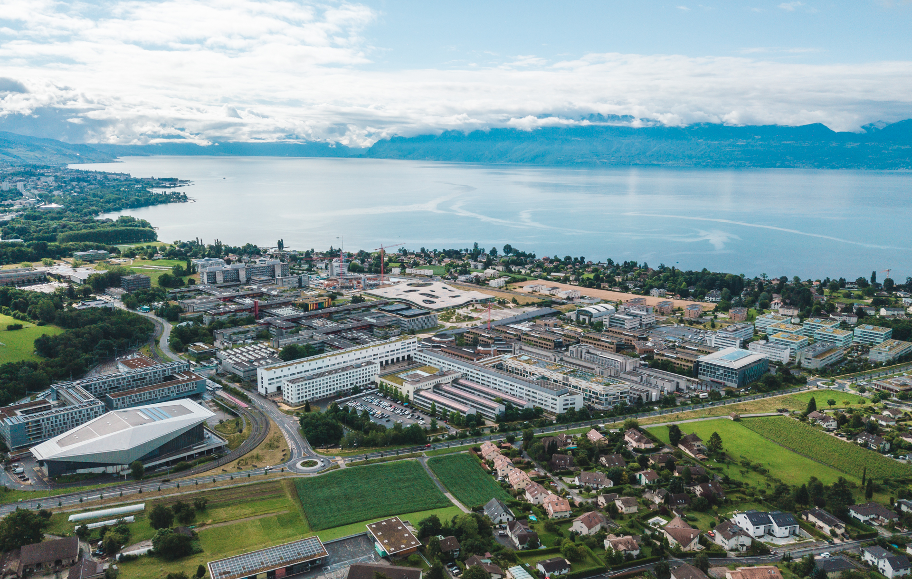
IAPR Final Project Spring 2023
Gianluca Radi
Alessandro Dalbesio
Camillo Nicolò De Sabbata
Group 5

Slide 2
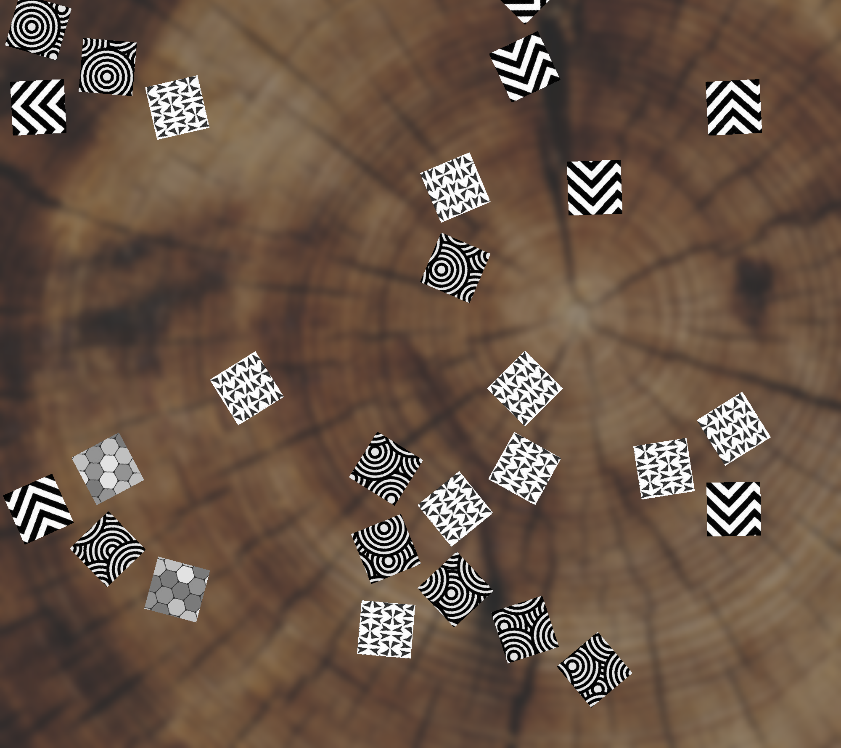
Introduction
Input: some images of size 2000x2000.
Problem: we have mixed pieces from two (or more) puzzles that need to be segmented and clustered.
Goal: Regroup the puzzles

Slide 3
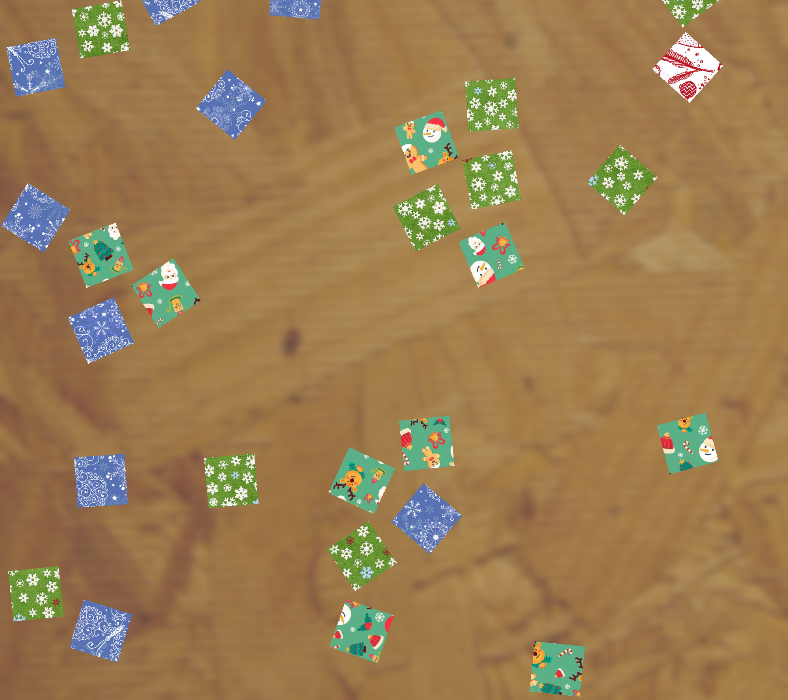
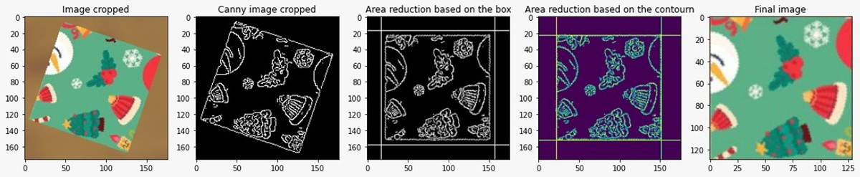
Introduction
To reach our goal, we have implemented a three-step chain:
Segmentation
Feature extraction
Clustering
FEATURES EXTRACTION
&
CLUSTERING
INPUT
SEGMENTATION
PUZZLE 1

Slide 4
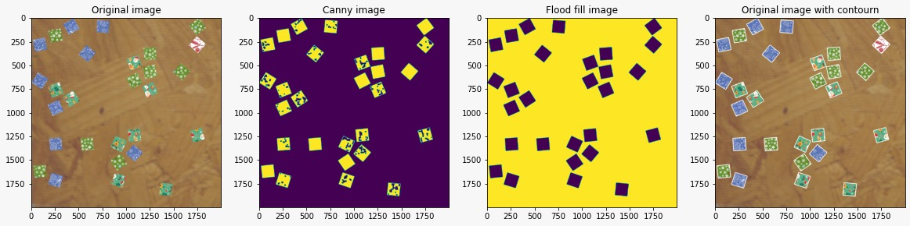
Segmentation
The segmentation is divided in two main phases:
Pieces labelling
Pieces extraction
Pieces Labelling
Pieces Extraction

Slide 5
Pieces Labelling
The pieces labelling is based on four steps:
Edge detection with Canny filter
Post processing of the obtained image with morphological operations
Flood fill to separate the objects from the background
Object labeling from the flood fill image and superimposition of the found contour on the original image

Slide 6
Pieces Extraction
The pieces extraction is based on four steps:
Cropping based on the contourn found in the pieces labelling step
Edge detection with Canny filter
Pieces rotation
Cleaning of obtained image (eliminate other pieces’ fragments)
Contour detection to identify where to crop the original rotated piece

Slide 7
Features Extraction
Based on two parts:
Pre-trained network CNN (VGG16) to extract all the features.
PCA to extract the best features (the ones with the highest variance). 8 features to mitigate the curse of dimensionality.

Slide 8
Clustering
Based on three steps:
Discover the possible combinations of puzzles sized based on the number of extracted pieces.
For every found combination, we employ a custom K-Means algorithm to form clusters of only compatible sizes (i.e. 23 pieces can only mean 12 + 9 + 2).
Now, for every clustering of the possible combinations, we choose the one that minimizes the intra-clusters variance.

Slide 9
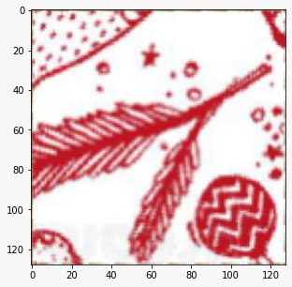
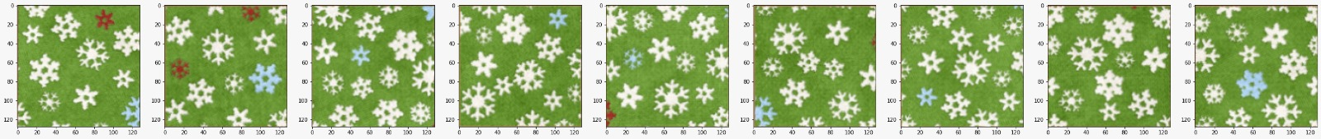
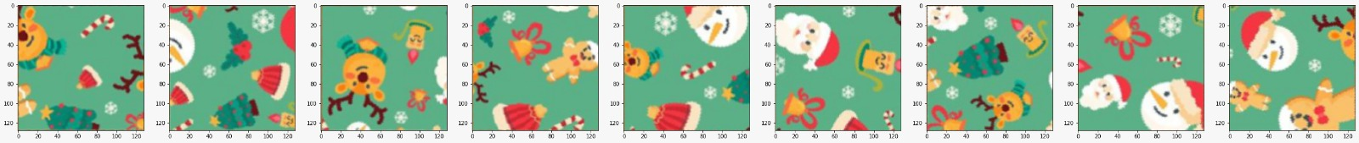
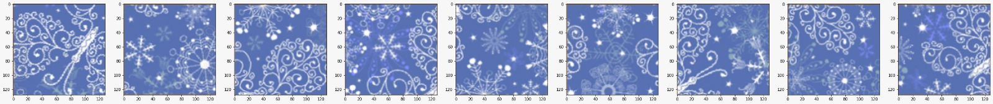
Clustering Result

